Slide 1

James Bond
Data analysis presented by: Katherine Howison, Melissa Benson & Cathy MacDonald

Slide 2
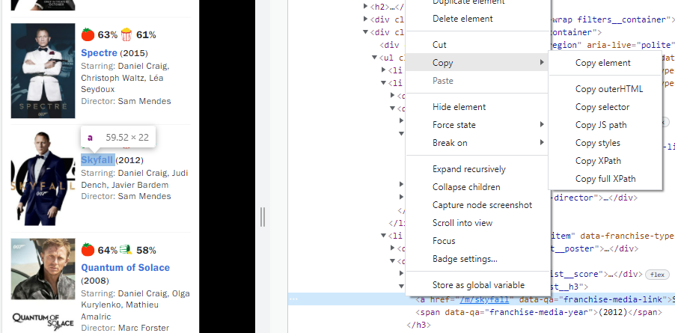
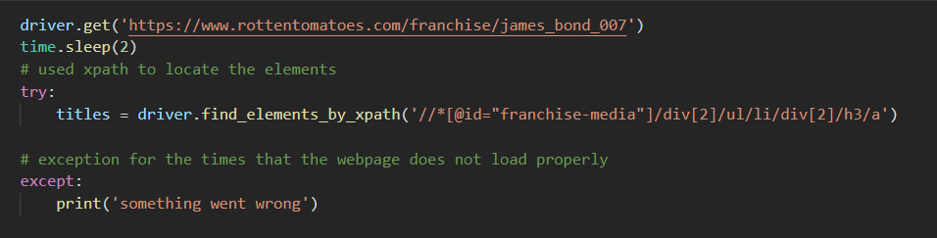
webscraping
Find element by xpath
A slightly different approach to the one we used in class

Slide 3

Python code
I had difficulty reading in some of the data to the d3 chart. I overcame these problems in two ways (this looks really simple, but it took me a few hours to work this out and overcome the data reading problems)
D
strings
A
T
integers
A
C
L
E
A
N
I
N
G

Slide 4
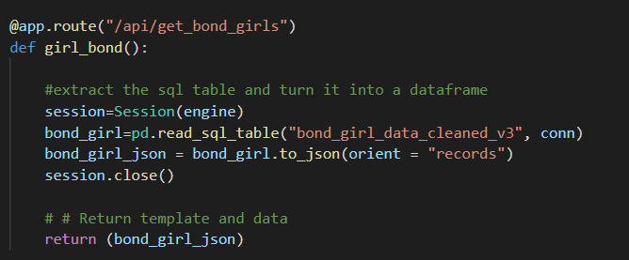
Access data
Use flask to access the database and jsonify data

Slide 5
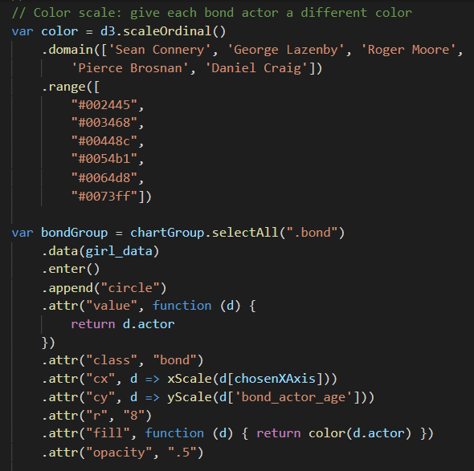
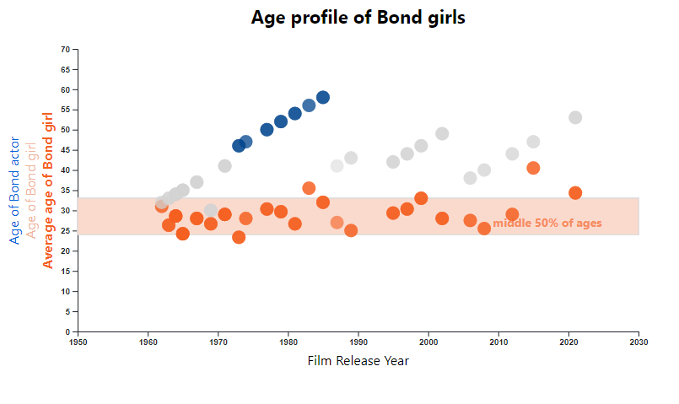
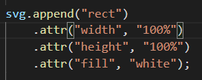
Charting with d3js
Add a value to each circle and use this value to assign colour and listen to in a click event.
Mostly I used the techniques covered in class, with a few additions.
I didn’t use the latest version of d3, because I couldn’t get the tooltips addin to work with the latest version.
Add a chart background (order matters)

Slide 6
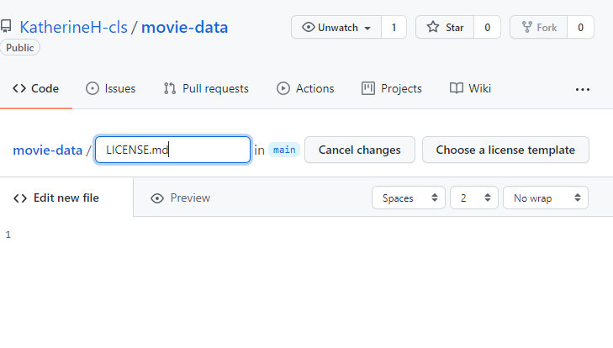
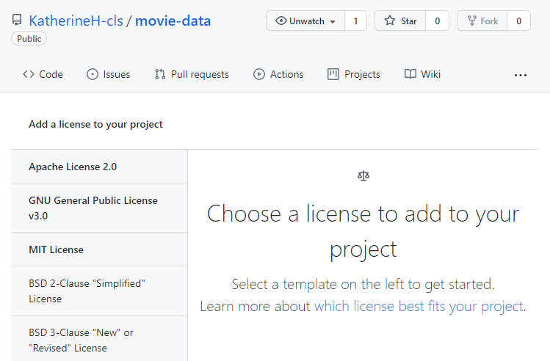
webpage
Javascript library – fullpage.js
link
https://alvarotrigo.com/fullPage/
docs
https://github.com/alvarotrigo/fullPage.js/#fullpagejs
Used to create fullscreen scrolling websites
Free for Open Source
fullPage v3 is an Open Source application licensed under a GPLv3 license. This license allows you to use fullPage in Open Source projects but it requires your project to be public and licensed under GPLv3
Create a license in github
Add file, call it LICENSE or LICENSE.md, select the appropriate license from a drop down list.

Slide 7
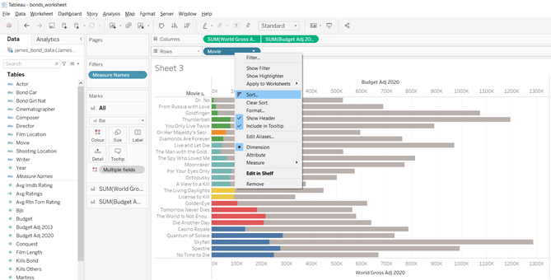
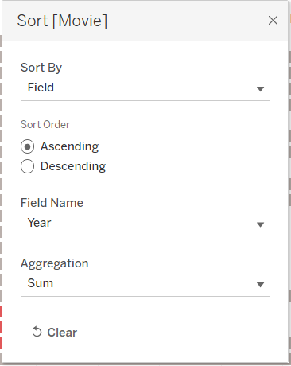
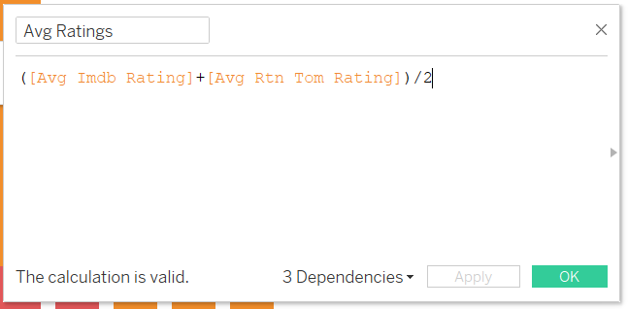
Tableau

Slide 8
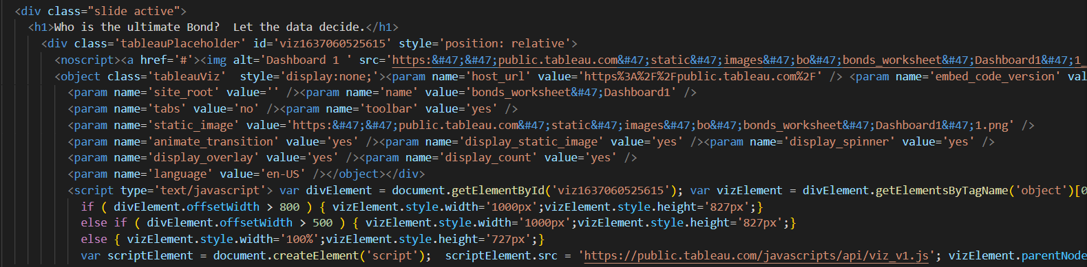
Embedding Tableau into HTML
Create Tableau public account
Connect Tableau desktop workbook to Tableau public
Share and embed information into HTML

Slide 9
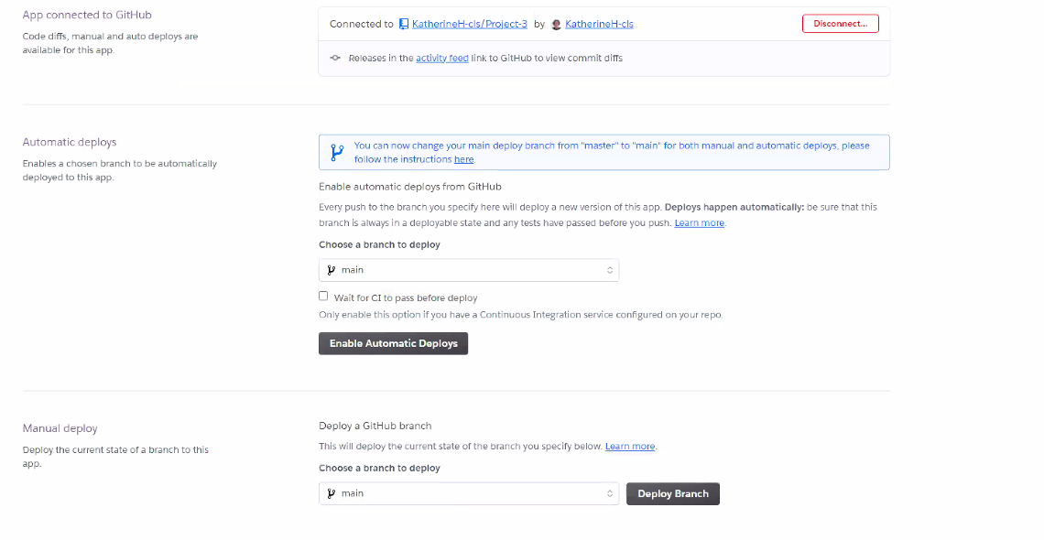
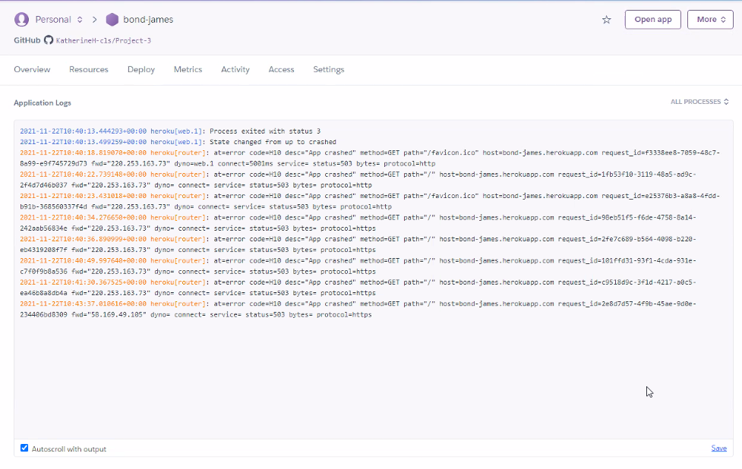
Heroku Deployment
Create procfile and requirements file
Connect Heroku to the Github page
Select manually deploy
Check Application Logs for errors in deployment

Slide 10
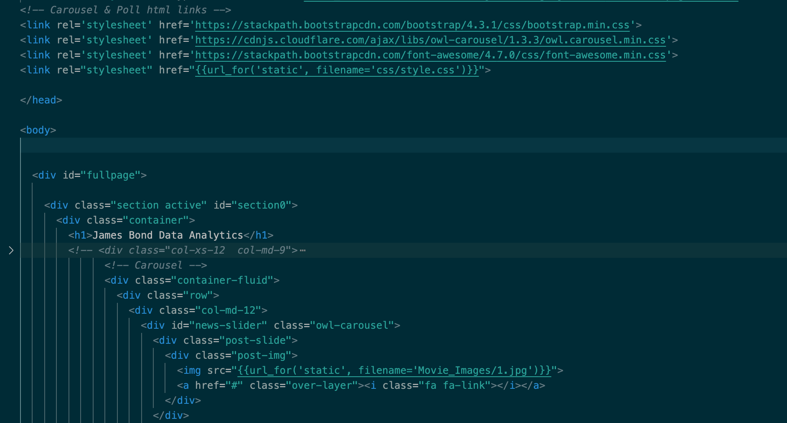
Cover page Carousel – HTML, JS & CSS
For a way to showcase all the Bond movies, originally I had planned to use it as a title piece for the top of the page, then the decision was to use it on the Cover for the Project.
I used the Owl Carousel, I found a few versions and adapted them to how I visually wanted it to be.
Background images were tried out many times and added via the use of CSS
Link for the newer version, not the variation I used
https://owlcarousel2.github.io/OwlCarousel2/

Slide 11
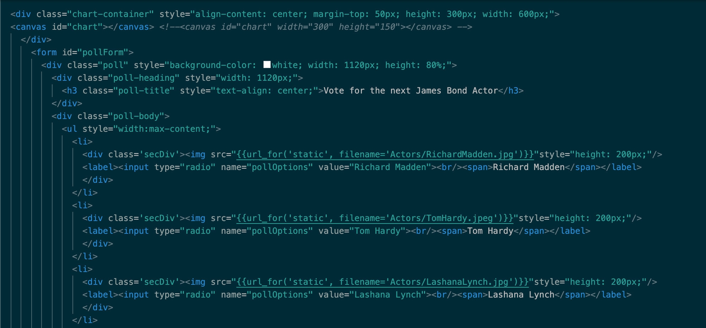
Voting for your Future Bond
Challenges:
Difficulty with adding images & realigning them within the HTML & CSS files
Linking the data to a database & Flask, this ended up being a monumental challenge that took a team effort to achieve, finalised by Kevin. A variety of methods were attempted including:
Mimicking the PetPals example
Using JS to add to a JSON or Excel file
Using SQL within the Flask app
Polling station example through the Flask website
Reviewing Homework to see if I could link it through Pandas
In the end, time and inexperience proved to be the limiting factors
I spent time assessing and adjusting different poll types that I found on the internet, looking for simple voting options where there could be a chart to display the results.
After I had the poll sorted, I then began adapting it to include images of the actors as the issue that not everyone knows actor’s names was raised.

Slide 12
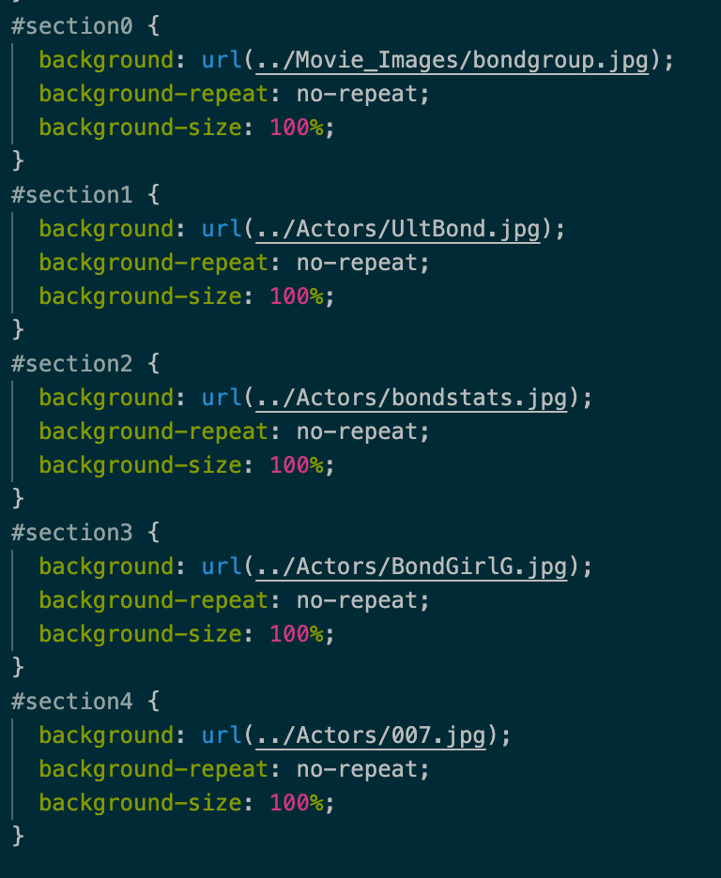
Image Additions
Images were added to the Carousel & Polls through the HTML file, the Background images were added via the CSS file.
Challenges:
- I googled the image size for standard websites thinking that if I ensured all images matched that then it would auto fit, it didn’t. I found that regardless of the size, they had a tendency to repeat themselves, after more google time, I learnt to put no-repeat against it.
- Screen size adjustments, based on the images created / used, I found that unfortunately they didn’t work as well once you adjusted your screen size, the only work around I could think of is to create new background images based on the different sizing. The other less fun option would be to have a more basic background.

